Slide 1


Zhuoheng Han
03/07/2023

Slide 2

Outline
Executive Summary
Introduction
Methodology
Results
Conclusion
Appendix

Slide 3
Executive Summary
Summary of methodologies
Data collection with Web scraping
Data Wrangling
Exploratory Data Analysis
Machine Learning Prediction
Summary of all results
Exploratory Data Analysis Results
Interactive Dashboard
Evaluation of Models

Slide 4
Introduction
Background: The commercial space age is here, companies are making space travel affordable for everyone. SpaceX, the most successful provider, advertises Falcon 9 rocket launches on its website with a cost of 62 million dollars; other providers cost upwards of 165 million dollars each, much of the savings is because SpaceX can reuse the first stage. Therefore, if we can determine if the first stage will land, we can determine the cost of a launch.
Goal: use public information and train a machine learning model to predict if SpaceX will reuse the first stage so that company can save cost.

Slide 5

Section 1

Slide 6
Methodology
Executive Summary
Data collection methodology:
Web-scraped from Wikipedia
Perform data wrangling
Perform exploratory data analysis (EDA) using visualization and SQL
Perform interactive visual analytics using Folium and Plotly Dash
Perform predictive analysis using classification models

Slide 7
Data Collection - Scraping
Request the Falcon9 Launch Wiki page from its URL
Extract a Falcon 9 launch records HTML table from Wikipedia
Parse the table and covert it into data frame
https://github.com/HanZhuoheng/SpaceX.git

Slide 8
Data Wrangling
Identify and calculate the percentage of the missing values in each attribute
Identify which columns are numerical and categorical
Exploratory Data Analysis
Calculate the number of launches on each site
Calculate the number and occurrence of each orbit
Calculate the number and occurrence of mission outcome per orbit type
Create a landing outcome label from Outcome column
https://github.com/HanZhuoheng/SpaceX.git

Slide 9
EDA with Data Visualization
Scatter plot between
Flight number and launch site
Payload and launch site
Flight number and orbit type
Payload and orbit type to check the relationship between those variables
Bar chart with success rate of each orbit type to determine which orbit type has the highest and lowest success rate
Line chart of success rate along the year to show the trend of success rate by the year
https://github.com/HanZhuoheng/SpaceX.git

Slide 10
EDA with SQL
Display the names of the unique launch sites in the space mission
Display 5 records where launch sites begin with the string ‘CCA’
Display the total payload mass carried by boosters launched by NASA (CRS)
Display average payload mass carried by booster version F9 v1.1
List the date when the first successful landing outcome in ground pad was achieved
List the names of the boosters which have success in drone ship and have payload mass greater than 4000 but less than 6000
List the total number of successful and failure mission outcomes
List the names of the booster versions which have carried the maximum payload mass
List the records which will display the month names, failure landing outcomes in drone ship ,booster versions, launch site for the months in year 2015
Rank the count of successful landing outcomes between the date 04-06-2010 and 20-03-2017 in descending order
https://github.com/HanZhuoheng/SpaceX.git

Slide 11
Build an Interactive Map with Folium
Mark all launch sites on a map
Mark the success/failed launches for each site on the map
Calculate the distances between a launch site to its proximities
https://github.com/HanZhuoheng/SpaceX.git

Slide 12
Build a Dashboard with Plotly Dash
Build an interactive Plotly dashboard with
A launch site drop-down input component to allow users to choose launch site that they are interested
A success rate pie chart based on selected launch site
A range slider for users to select payload
A scatter plot showing the relationship between payload mass and success outcome
https://github.com/HanZhuoheng/SpaceX.git

Slide 13
Predictive Analysis (Classification)
Data Preprocessing
Load the data
One-hot encode
Create the independent and dependent variables
Standardize the independent variables
Split data into training (80%) and test (20%) dataset
Model Building
Decide the models to use
Create parameters for different models
Model Evaluation
Create parameters for different models
Find the best parameter using GridSearchCV on training set for each model
Calculate the accuracy on the test data and plot the confusion matrix for each model
Model Selection
Compare the accuracy scores and confusion matrices to find the best model
https://github.com/HanZhuoheng/SpaceX.git

Slide 14
Results
Exploratory data analysis results
Interactive analytics demo in screenshots
Predictive analysis results

Slide 15

Section 2

Slide 16
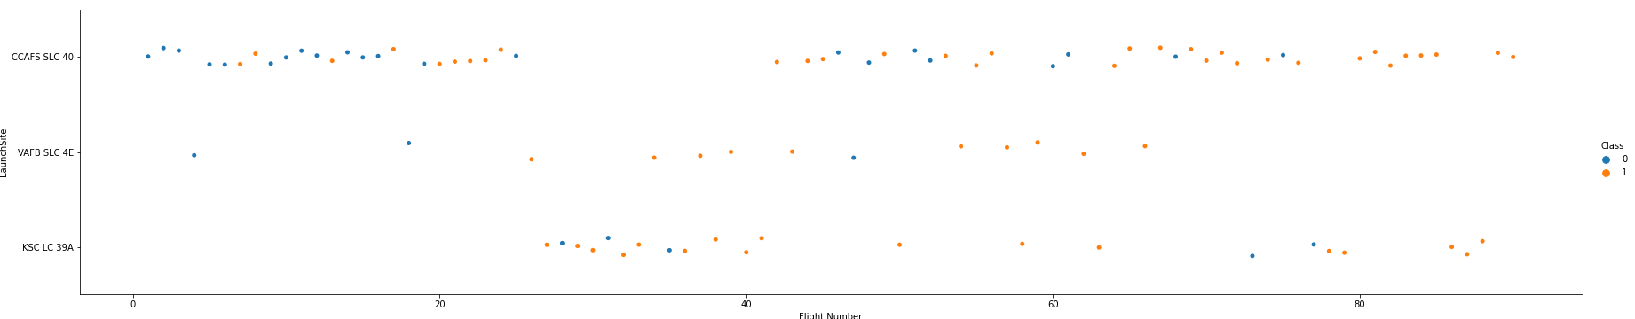
Flight Number vs. Launch Site
Most failures were happened at the first 20 flights and at CCAFS SLC 40 launch site

Slide 17
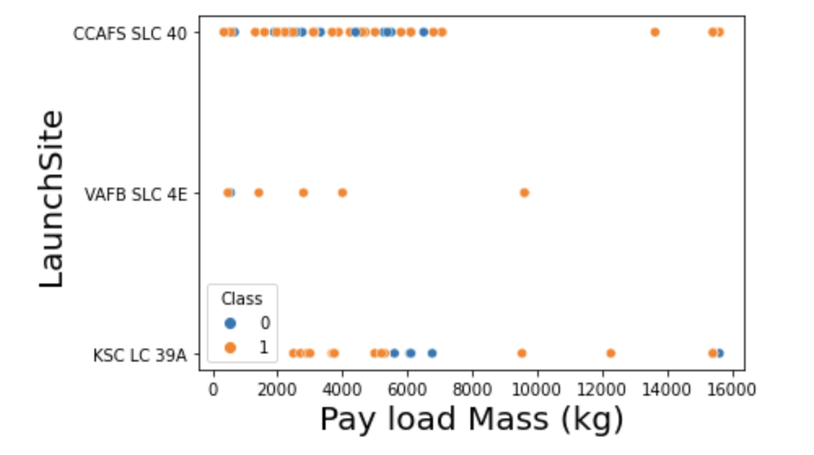
Payload vs. Launch Site
From the scatter plot, there were no rockets launched for very heavy payload mass (greater than 10000kg) at VAFB-SLC launch site
Most rockets were with payload smaller than 8000kg and the success rate was higher when the payload mass greater than 8000kg

Slide 18
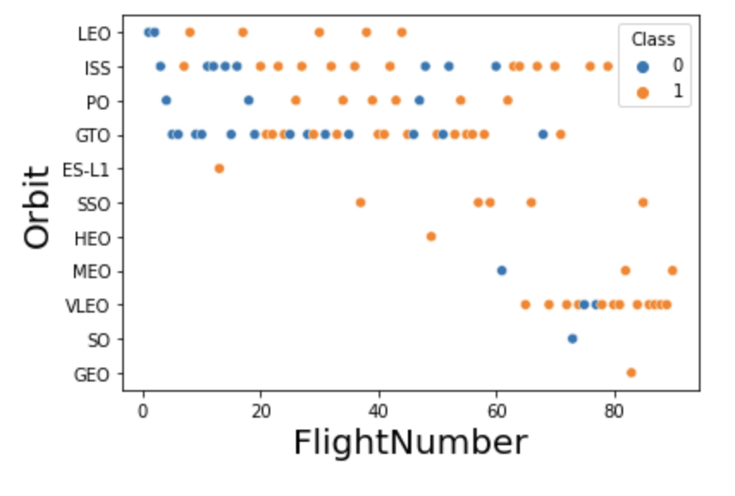
Flight Number vs. Orbit Type
For LEO orbit, the success appeared that was related to the number of flights; on the other hand, there seemed to be no relationship between flight number when in GTO, ISS, PO orbits.

Slide 19
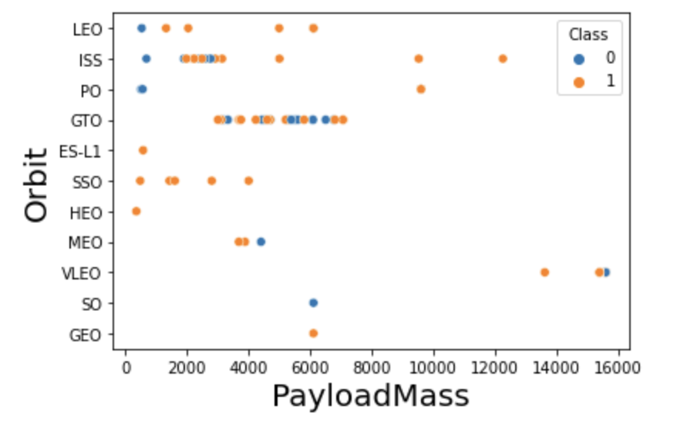
Payload vs. Orbit Type
With heavier payloads the successful landings were more for PO, LEO and ISS. By Contrast, the unsuccessful rate were more for MEO and VLEO
For Orbit GTO, it was hard to distinguish success rate based on payload mass

Slide 20
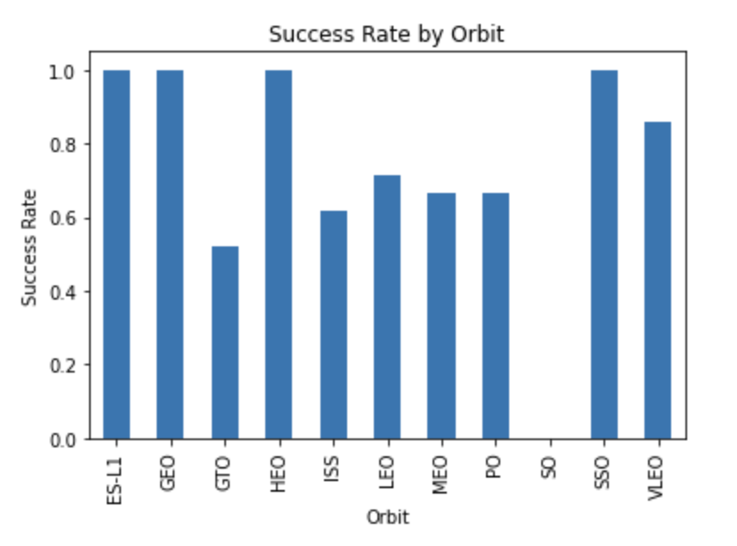
Success Rate vs. Orbit Type
From the bar plot, Orbits ES-L1, GEO, HEO, and SSO had the highest success rate, which equals 1. Orbit SO was the only one with 0 success rate
However, Orbit ES-L1, GEO, HEO, and SO only had one record, so we need more data in the future to draw a conclusion

Slide 21
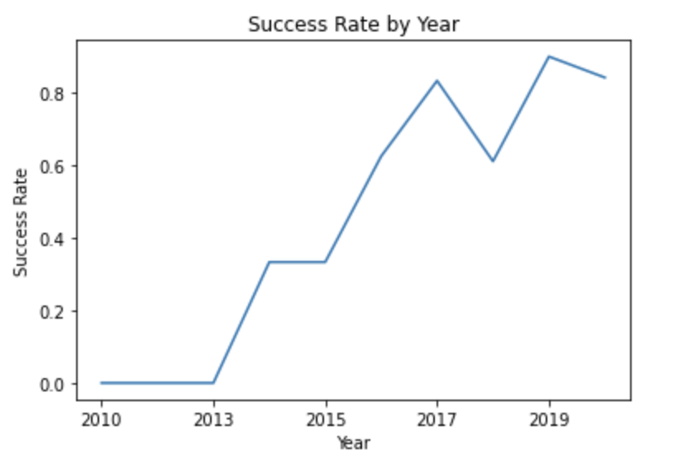
Launch Success Yearly Trend
From 2010 to 2013, the success rate stayed at 0
Starting from 2013, the success rate overall kept increasing till 2020
There was a drop in 2018

Slide 22
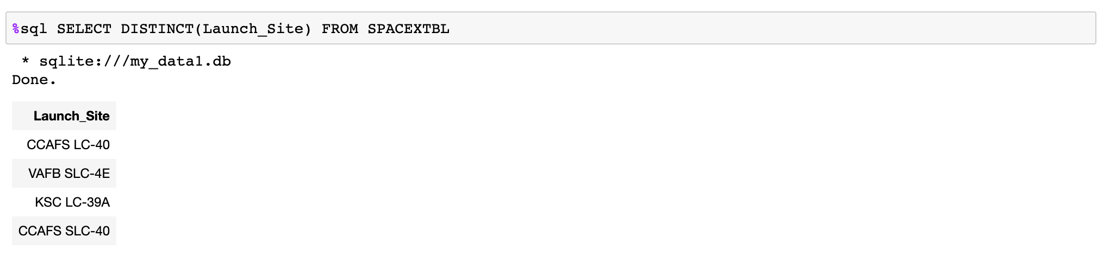
All Launch Site Names
Used DISTINCT function to find the unique launch sites

Slide 23
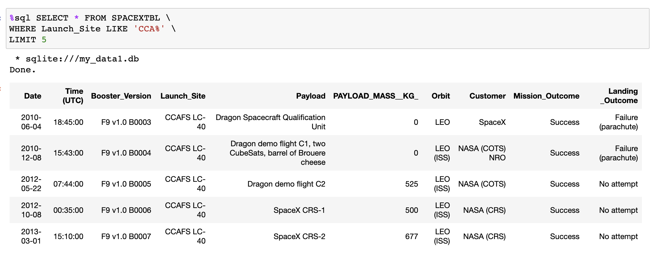
Launch Site Names Begin with 'CCA'
Used WHERE and LIKE function to find the launch site names beginning with ‘CCA’ and Used LIMIT to show the top 5 records

Slide 24
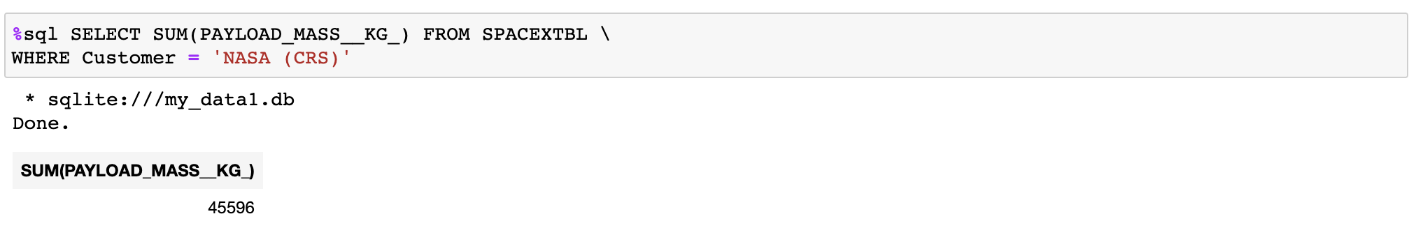
Total Payload Mass
Used WHERE to find boosters launched by NASA (CRS) and used SUM function to calculate the total payload mass

Slide 25
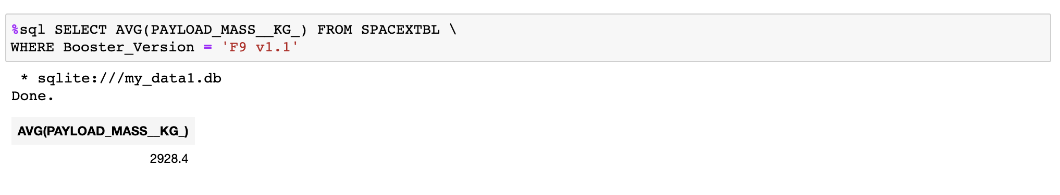
Average Payload Mass by F9 v1.1
Used WHERE to find boosters F9 v1.1 and used AVG function to calculate the mean payload mass

Slide 26
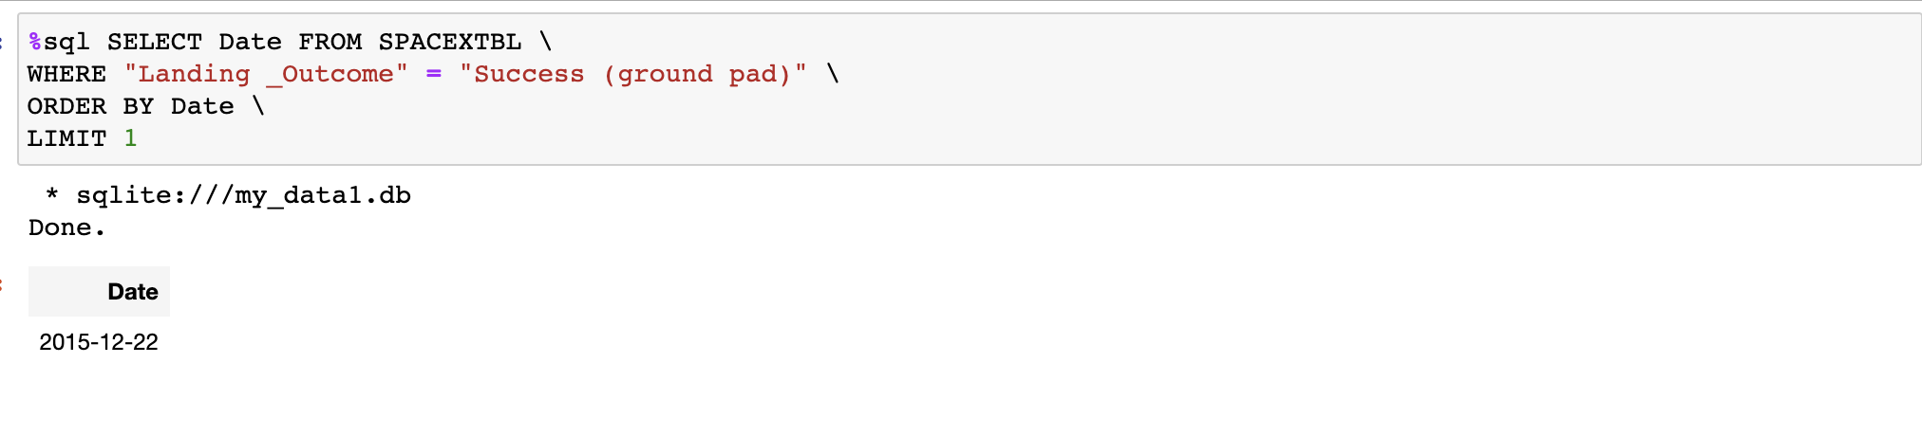
First Successful Ground Landing Date
Used WHERE to find successful ground landing and used ORDER BY and LIMIT 1 to find the earliest date

Slide 27
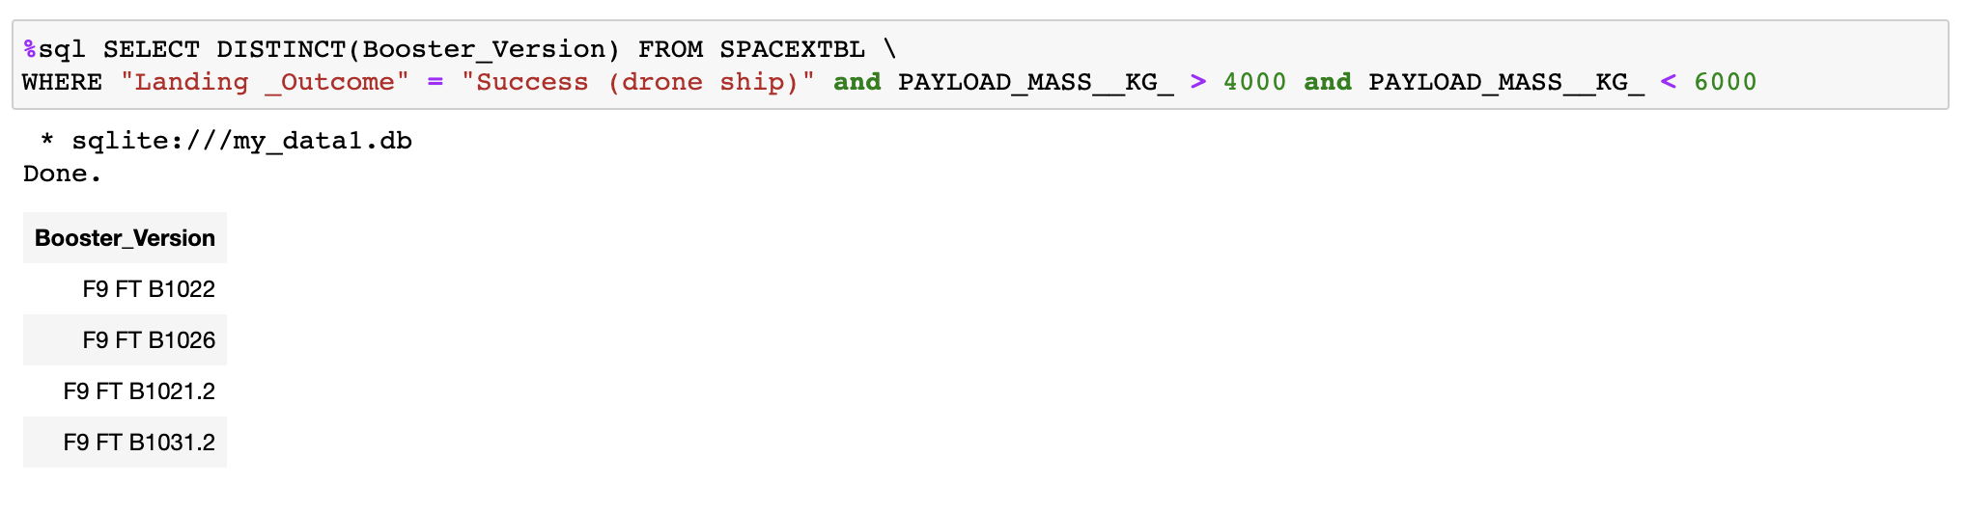
Successful Drone Ship Landing with Payload between 4000 and 6000
Used WHERE to find successful drone ship landing and filter payload mass between 4000 and 6000 and used DISTINCT to find the unique booster version

Slide 28
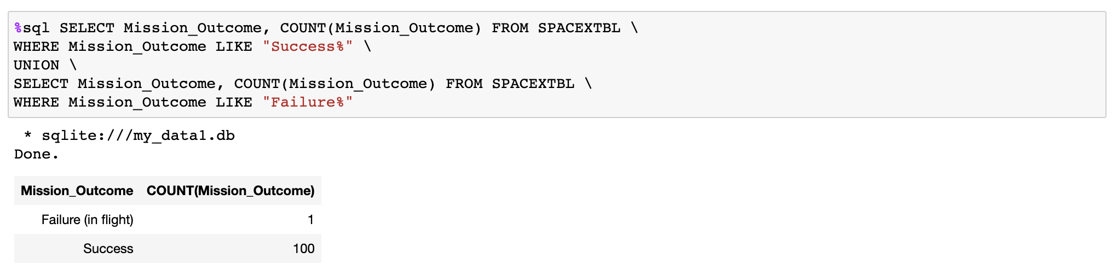
Total Number of Successful and Failure Mission Outcomes
Used WHERE and ‘Success%’ to find all successful mission outcomes and ‘Failure%’ to find all fail mission outcomes. Then, used COUNT to calculate total outcomes for both outcomes. Finally, used UNION to merge two query outcomes into one table.

Slide 29
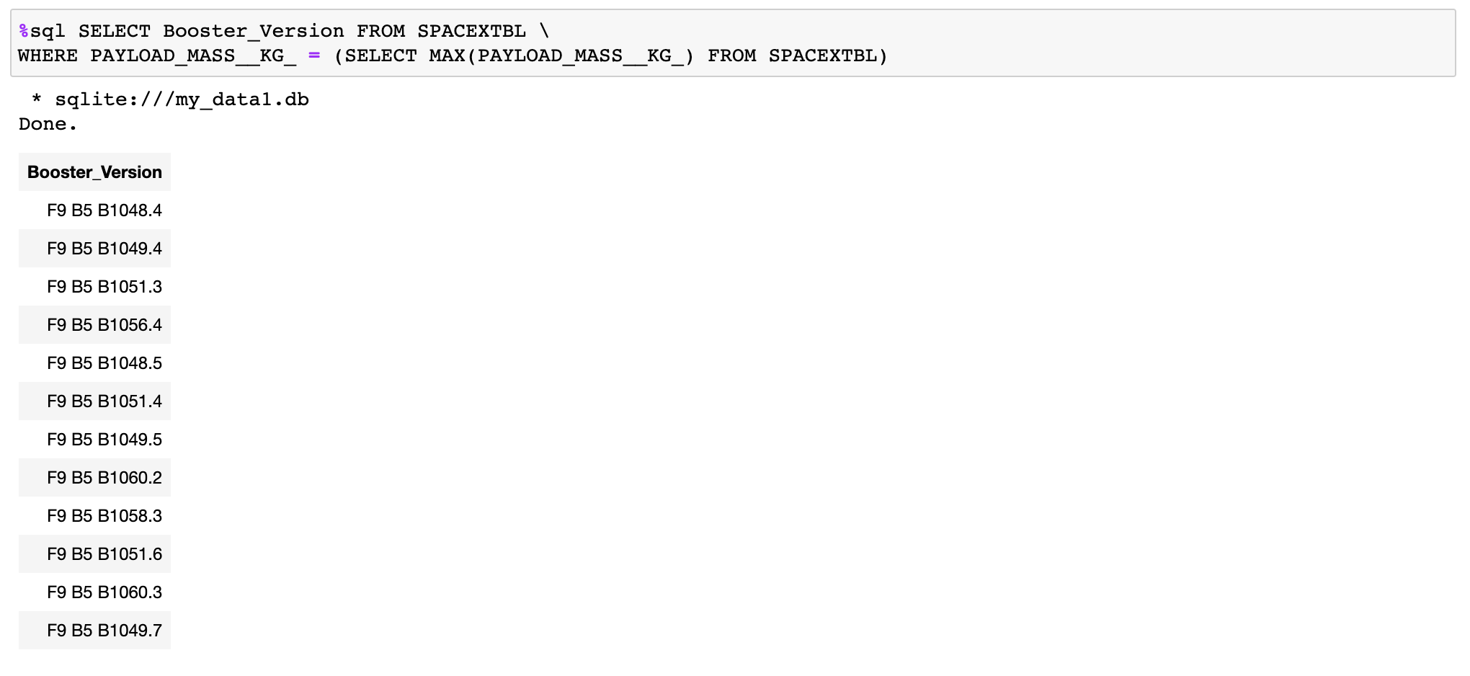
Boosters Carried Maximum Payload
Used subquery with MAX function to find the maximum payload and used WHERE to find the booster versions have the maximum payload

Slide 30
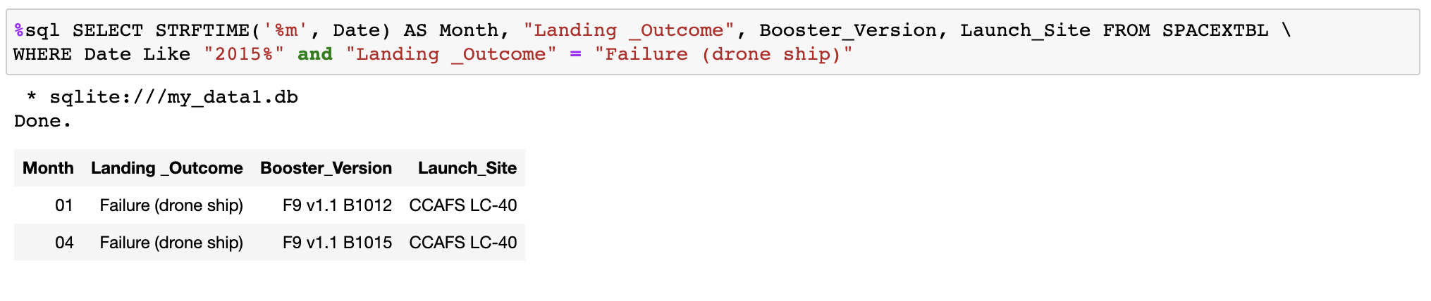
2015 Launch Records
Used WHERE and ‘2015%’ to find 2015 year and “Failure (drone ship)” to find the failure drone ship outcomes. Then, selected month using STRFTIME to find the month

Slide 31
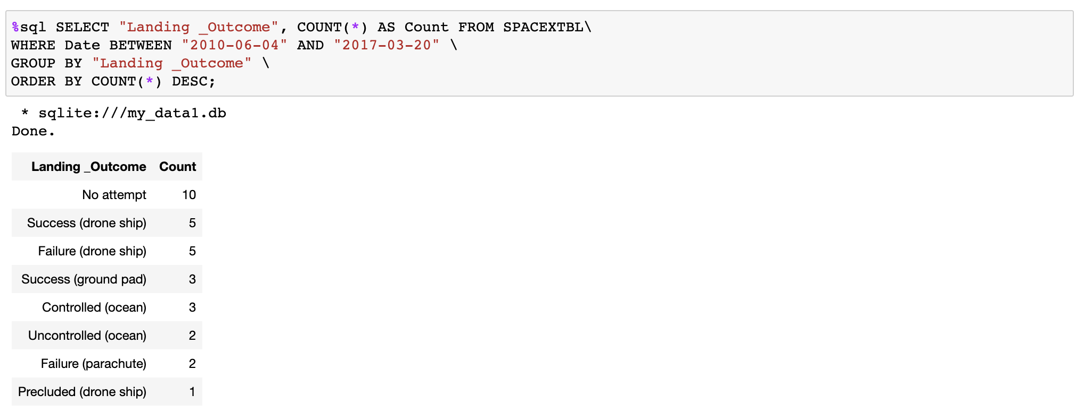
Rank Landing Outcomes Between 2010-06-04 and 2017-03-20
Used WHERE and BETWEEN to find the date between 2010-06-04 and 2017-03-20 and used GROUP BY and COUNT to count each landing outcome. Finally, used ORDER BY and DESC to rank the count from most to least.

Slide 32

Section 3

Slide 33
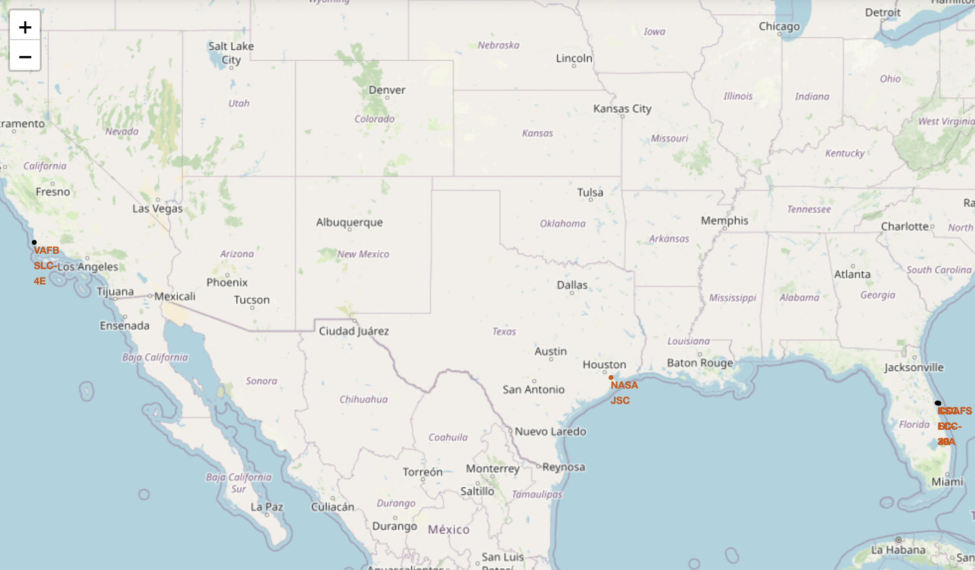
Launch Site Locations
All launch sites were in proximity to the Equator line and by the coast

Slide 34
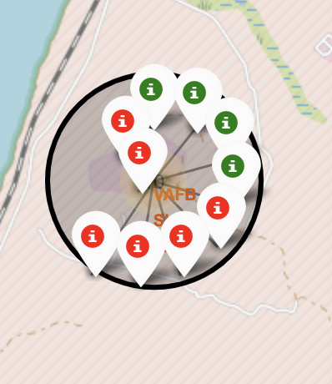
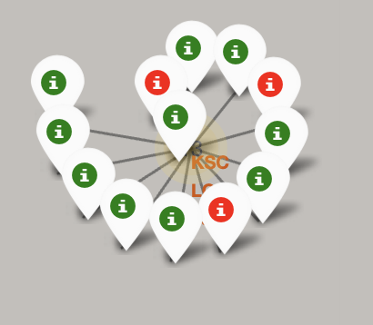
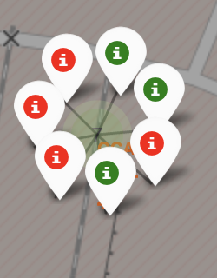
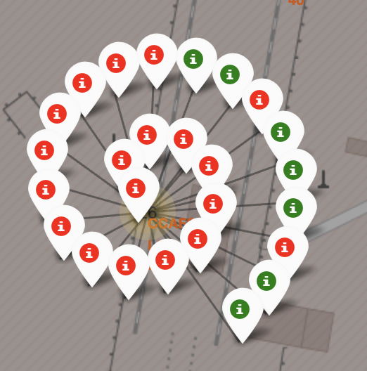
Launch Outcomes
Green markers show successful outcomes
Red markers show failed outcomes
There were no patterns of launch outcomes in each launch site. Each site had success and failure.
VAFB SLC-4E
KSC LC-39A
CCAFS SLC-40
CCAFS LC-40

Slide 35
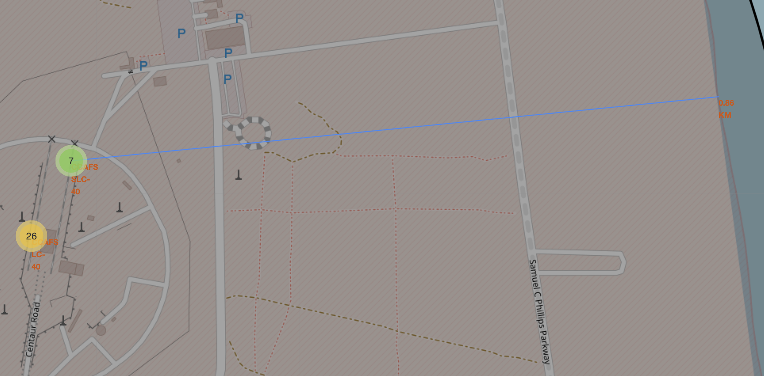
Distance to closest coastline
The distance to closest coastline from CCAFS SLC-40 was about 0.86km, which was very close to the coastline.

Slide 36

Section 4

Slide 37
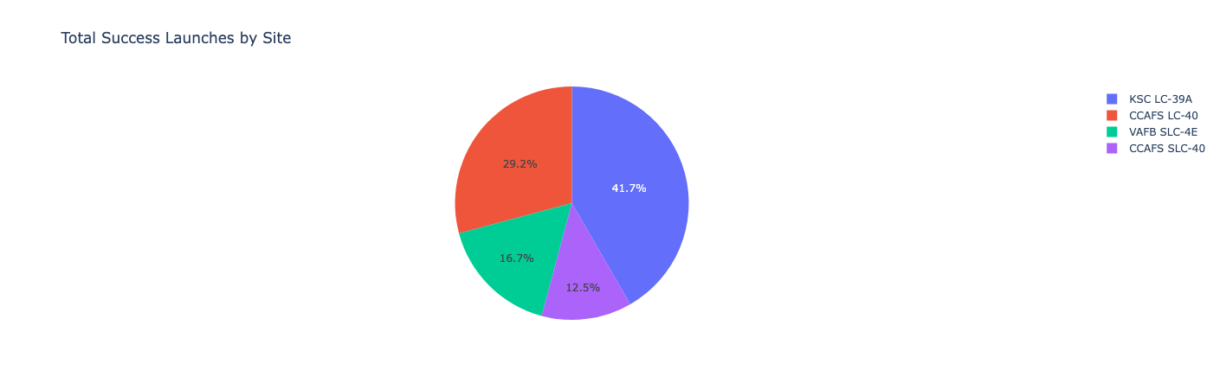
Total Successful Launches by Sites
KSC LC-39A had the highest number of launch success, while CCAFS SLC-40 had the lowest

Slide 38
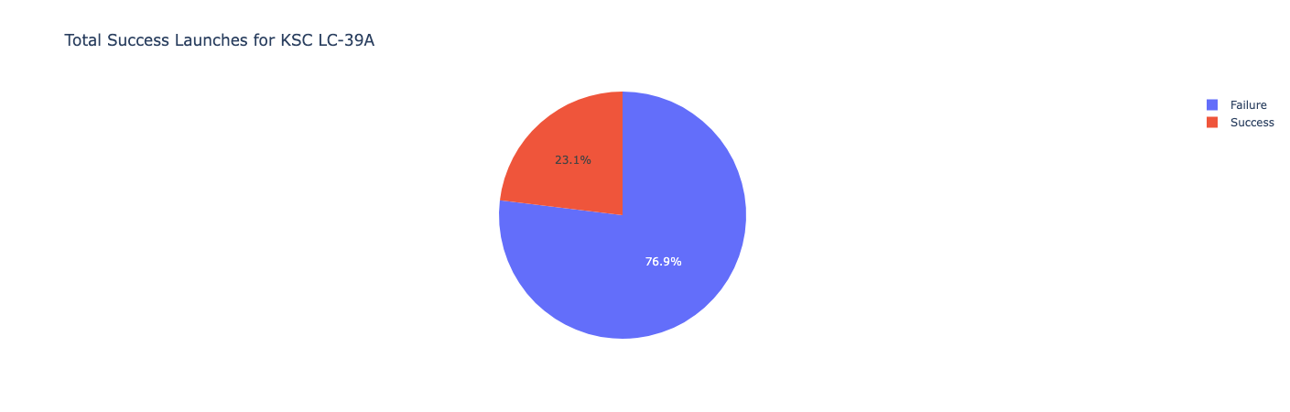
Success Ratio for KSC LC-39A
KSC LC-39A had the highest success ratio, which was 76.9%

Slide 39
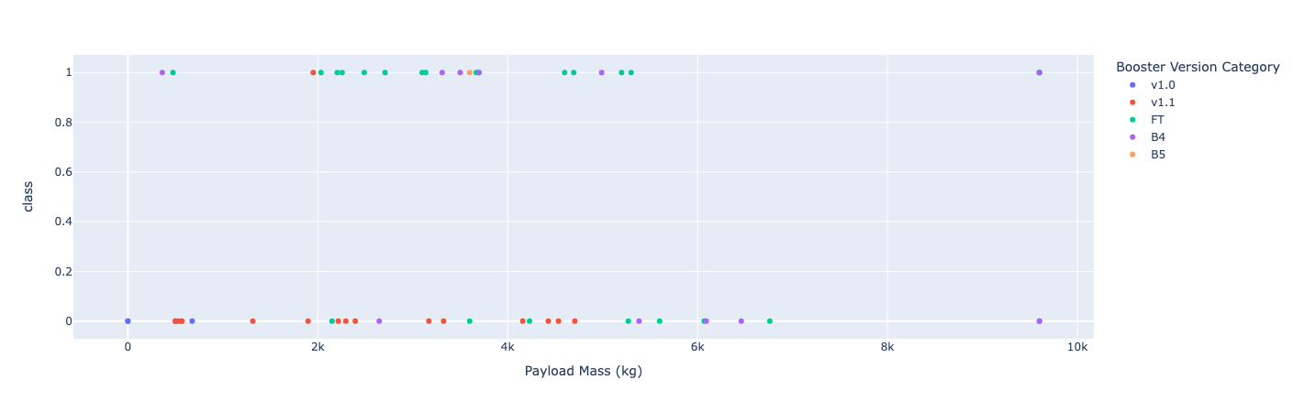
Payload vs. Launch Outcome
With payloads greater than 6000kg, launches had more unsuccessful outcomes
Booster Version v1.1 had more unsuccessful launch outcomes

Slide 40

Section 5

Slide 41
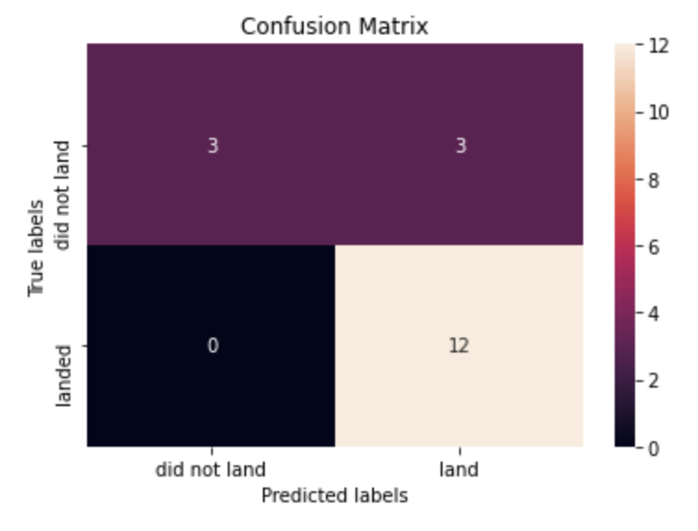
Classification Accuracy
We build 4 classification models logistic regression, support vector machine, tree classifier, and k nearest neighbors. They give the same test accuracy 0.833, precision 0.8, and recall 1.

Slide 42
Conclusions
The higher weighted payloads (over 8000 kg) perform better than the low weight ones
KSC LC-39A had the highest success ratio, which was 76.9%
SSO Orbit had the highest success rate 1 and had more than one launch
Starting from 2013, the success rate kept increasing
All classification models gave the same test accuracy 0.833 and the major problem is false positive.

Slide 43


